Slide 1
Ibero-American Alliance for Rare Diseases ALIBER
Dr. Jesús Navarro
Vice-President

Slide 2
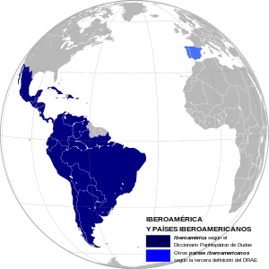
What is ALIBER?
Alianza Iberoamericana de EE.RR.
ALIBER is the Ibero-American network of entities for Rare Diseases, founded in 2013 at the First Ibero-American Meeting for Rare Diseases, in Totana, Spain.
Our MISSION is to coordinate actions to strengthen the associative movement, give visibility to RD and represent people with this pathologies in Ibero America by creating a permanent exchange space to share knowledge, experiences and best practices.
15 countries
52 members
+ 500 PO
47 MM of
people
Notes:
ALIBER is a young organization, founded five years ago during the first Ibero American meeting for Rare Diseases in Totana, Spain, by 11 patient organizations.
Nowadays we have 52 members from 15 countries that represent more than 500 patient organizations and 47 millions of people with RD.
Our mission is to coordinate actions to strength the associative movement, give visibility to RD and represent people with RD in Ibero America, by creating a permanent exchange space to share knowledge, experiences and best practices.

Slide 3
Memberships & collaborations
REDidi
Red Iberoamericana para la Docencia e Investigación en Derechos de la Infancia
Notes:
Formamos parte de RDI y participamos en IRDIRC, COINER y el Post Grado la Voz del Paciente
Hemos firmado convenios con la UCAM, FUNEDERE (pendiente), El Banco de Protección Social de Uruguay, la Federación Mundial de Peñas del FC Barcelona y el Real e Ilustre Colegio de Farmaceutas de Sevilla

Slide 4
Developing knowledge
The Associative Movement of Rare Diseases in
Ibero America
Notes:
In order to fulfill our mission, we have developed some projects as the Study of Associative Movement of Rare Diseases in Ibero America.

Slide 5
Main findings
Patient Organizations (PO) are young (M: 11 years; Range: 1 – 46 years) and medium-sized (M: 316 members; Range: 0 – 5.000)
Led by affected women or relatives of people with RD (83% in LATAM)
Have restricted financial sources that limit its services and hiring of qualified personnel.
Main task: To provide information and guidance on RD.

Slide 6
Main findings
Work with governments and States to promote agreements that allow the inclusion of people with RD,
Advocacy and development of legal frameworks that protect the rights of those affected.
Leaders are aware of their training needs (organization management, orphan drugs, research, public policies), as well as those of patients and health professionals.

Slide 7
Priority tasks
Advocacy:
Financial, infrastructure and equipment, development of legislation, creation of referral centers and patient registries, as well as access to treatment, especially as regards orphan drugs.
Training of patients, as a way of empowerment
Training of health professionals in RD
Map of RD resouces
Notes:
We are convinced that our next steps must be addressed to know the life conditions of people with RD in LATAM, and the resources that we have, or don’t have, for the diagnosis, treatment and care of those affected and their families.

Slide 8
Request to the WHO World Conference on NCDs
ALIBER, FEDER & FADEPOF manifest asking for:
Updating the NCDs list
Creation of a subcategory of TNA that includes those that can only be prevented through secondary and tertiary prevention
Consider a proposal for the inclusion of health services, medical and therapeutic care for NCDs or preventable diseases within the basic set of benefits of universal health coverage.
Update of the list of essential medicines including those that according to scientific evidence are effective, safe and of quality for the treatment of diseases chronic, complex and rare diseases

Slide 9
Request to the WHO World Conference on NCDs
An integrated policy referring to access and rational use of medicines and essential and strategic health technologies, , including those that are considered high cost.
Apply intersectoral approaches in order to implement strategies and initiatives in relation to the 2030 commitment to "leave no one behind" in relation to chronic non communicable or preventable diseases
Establish commitments that translate into legislative and regulatory measures, investments and financing of programs against "diseases not transmissible or preventable through primary prevention"

Slide 10
2019 main projects
ENSERio - LATAM Study
Social and Health Needs of People with RD
Ibero American Information and Guidance Service for Rare Diseases (SIO-ALIBER).
Pilot project
Notes:
In this direction I‘d like to talk about our main projects for 2019.
The first one is the Study of Health and Social Needs of people with RD in LATAM, and the second is the Ibero American Information and Guidance service for RD, a pilot project that we want to develop with our partner in Uruguay, ATUERU.

Slide 11
ENSERiO LATAM Project
To characterize social and health needs in Latin American RD patients.
Socio-demographic characteristics.
Social and health care
Process to obtain diagnosis and treatment
Impact of RD in health, activity daily living, general behavior, and labor areas
Aspects that affect the social inclusion
RD associated costs and the cost coverage
Health professionals, referral centers or specialized care units
Notes:
To settle down this caractheristics we want to develop our study, in order to kow…

Slide 12
ENSERiO LATAM Project
Population
People with RD who lives in LATAM
43 millions of people
Sample
398 people for each country
Sampling
Non probabilistic, quota method.
Measure
Online questionnaire, available in Spanish and Portuguese
Sociodemographic data, Diagnosis and treatment information, Sickness impact, Cost of the disease, Resources map.
Notes:
In order to develop our project we have planned to collect a sample of almost 400 people for each country, through the quota sampling.
We will collect the data by using an online questionnaire, with questions about sociodemographic data, diagnosis and treatment information, sickness impact, cost of the disease, and resources availables.
The results let us to build a profile with this variables. These profiles could be the baseline that each country need in order to develop tailored plans to care of people with RD.
We are sure that the ENSERio LATAM Study results will mark before and after.

Slide 13
SIO-ALIBER Project
Final aim
To improve the QOL of people with RD in Latin America through the development of the SIO-ALIBER.
Procedure
To develop
a training program for SIO technicians
a resource guide (RDPOs and services) for RD attention in Latin America
To design a database to register requests & data for resources
To assess and select the best protection data legal framework
To implement a RD specific helpline in Latin America and to support the develop of local helplines
Notes:
That is why we consider that the creation of SIO ALIBER is unpostponable.
What we want to do is…
To reach that we have to work in order to …

Slide 14
Beneficiaries & Scope
Beneficiaries
Number of direct beneficiaries: 5.741
Women: 2.541
Children: 3.200
Number of indirect beneficiaries: 22.964
Number of potential beneficiaries: 28 million
Territorial scope
Latin America (except Brazil)
Notes:
We calculate the number of direct beneficiaries, on the base of the quantity of people attended by SIO from FEDER, and the indirect ones, multiplying this number by 4, which is the average of family members in LATAM, almost 23 thousand. Finally, we are talking about 28 millions of people as potential beneficiaries, which is the estimated number of people with RD in LATAM, without Brazil.

Slide 15
Pilot projet
Notes:
As firt stage, we will develop a pilot project in Uruguay and Colombia, with the support of the Spanish federation for RD (FEDER), the Social Security Institute from Uruguay, and two patient organizations: ATUERU from Uruguay and ASOIBEROAMC from Colombia. Additionallu, FCB World Penyes Federation and Real e Ilustre Colegio de Farmacéticos de Sevilla, colaboran económicamente con el SIO de ALIBER
FEDER is in charge of technicians training, and BPS has provided the infrastructure for service functioning in Montevideo.
The technicians are proportioned by ATUERU ans ASOIBEROAMC, and ALIBER is responsible for the service coordination, look for resources for the sustainability of the SIO, and the develop of tools as the database.

Slide 16
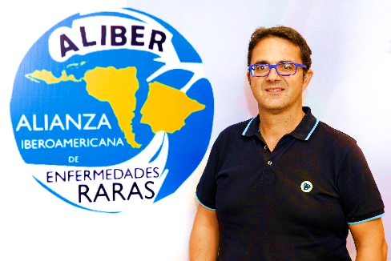
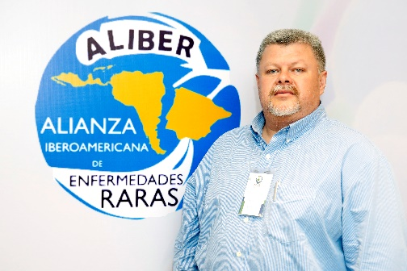
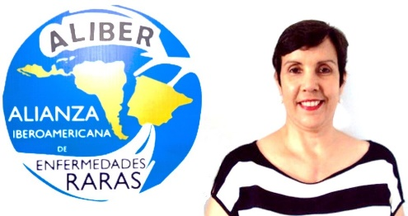
Contacts
Juan Carrión Tudela
President
presidencia@aliber.org
+34 690 945 233
Jesús Navarro
Vice- President vicepresidencia2@aliber.org
+52 1 33 3106 3400
Gloria Pino Ramírez
Executive Director
direccion@aliber.org
+34 722 643 492

