Slide 1
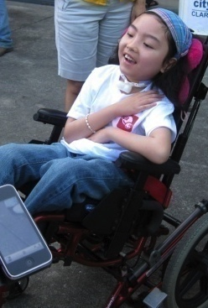
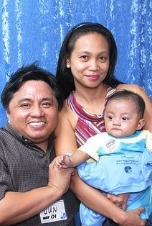
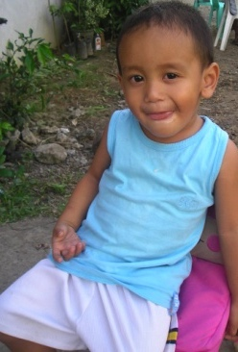
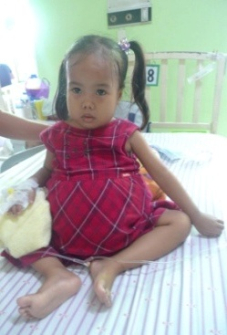
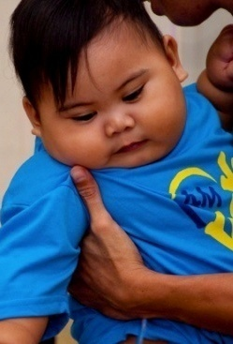
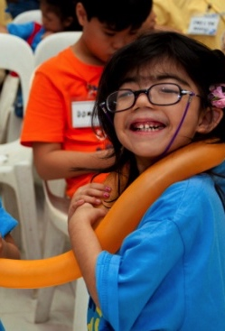
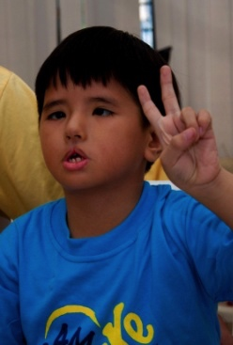
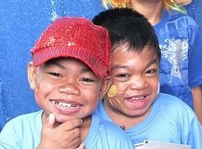
Integration of Rare Diseases in the Philippine National Health System
Rare Diseases International 2019 General Assembly
20 February 2019
New York
Cynthia K. Magdaraog
President
Philippine Society for Orphan Disorders, Inc.
1

Slide 2
Topic Coverage
Milestones
PSOD’s contribution to the passage of the Rare Diseases Act
Salient features of the Rare Diseases Act
Provisions on the pending Universal Health Care Act impacting implementation of the RDA
Persons With Rare Diseases Claim: Our to Right to Life

Slide 3
Milestones
2019: Consolidated UHC Bill submitted for signature
1990’s: Early case findings of PWRD
2006: Formation of PSOD
Republic Act 10747
Rare Diseases Act of the Philippines
2016
Republic Act 9288
Newborn Screening Act of 2004

Slide 4
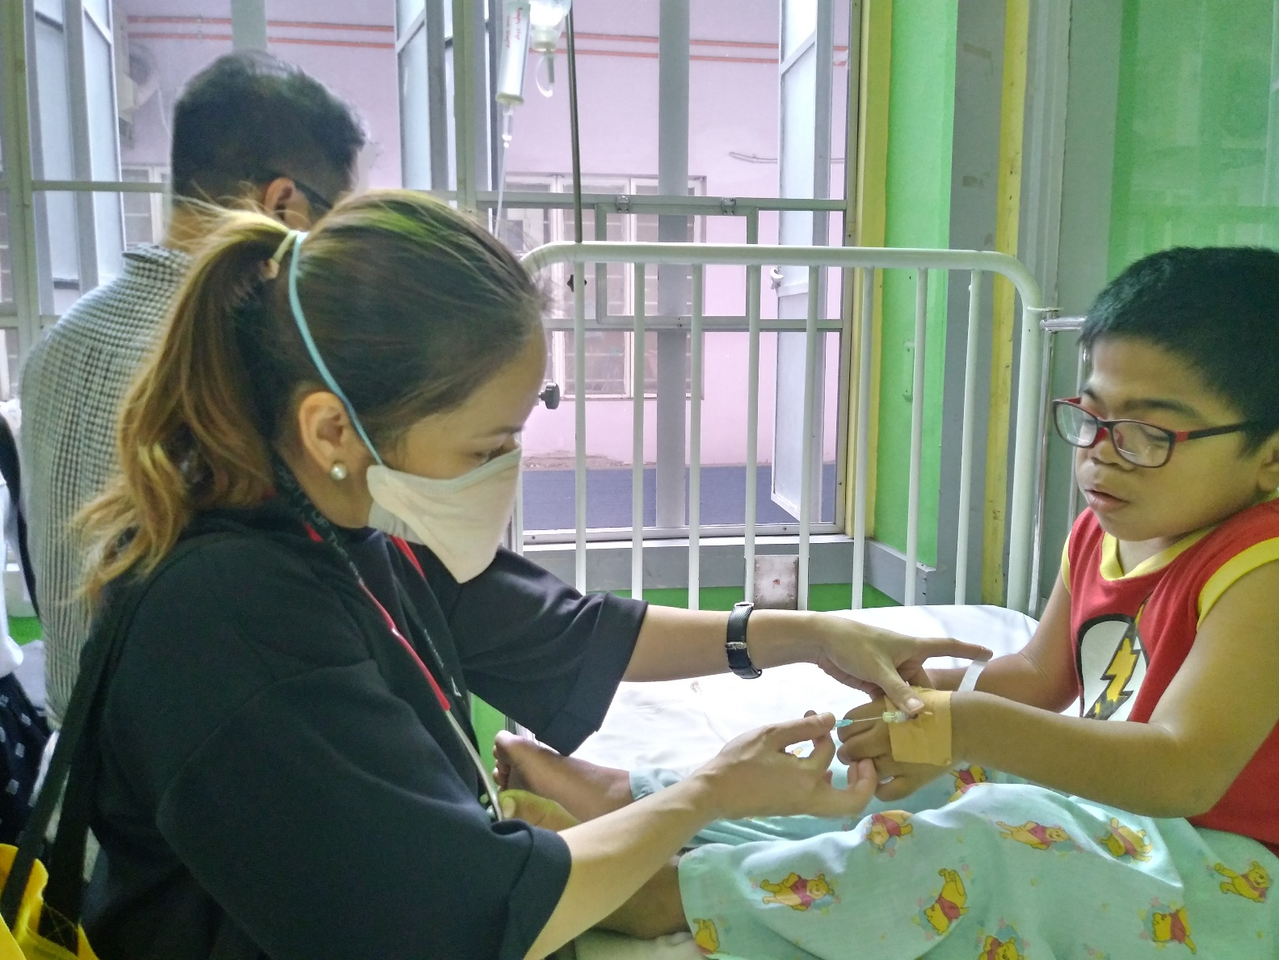
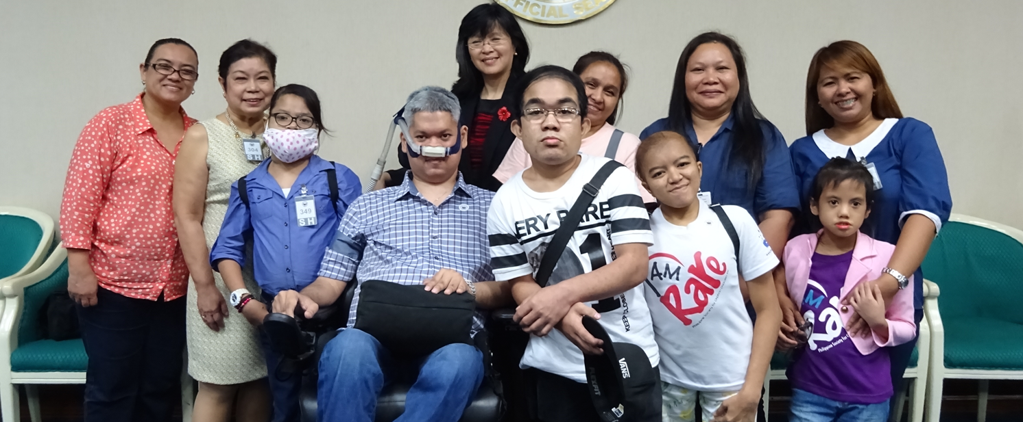
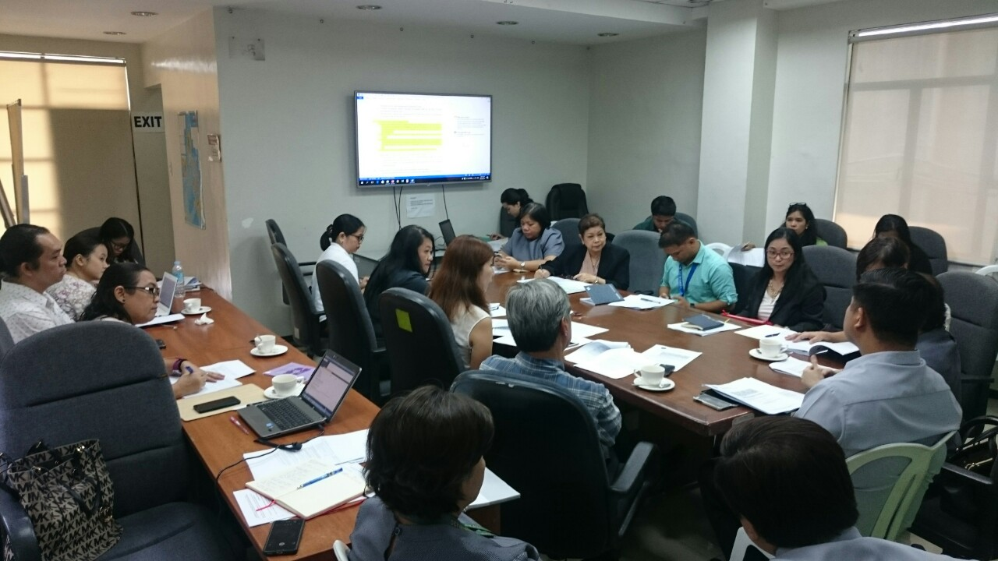
PSOD’s Contribution to the Passage of the RDA
Ground level lobbying for the passage of RDA
Member of the Technical Working Group
Rare Disease Medicine Access Program
2011, 2013 and 2018

Slide 5
Salient Features of the Rare Diseases Act
Policy Declaration: The RDA mandates that persons suffering with rare disease have the right to survival and full and healthy development through access to timely health information and adequate medical care that is :
COMPREHENSIVE
NBS continuity care nationwide
Telegenetics
Rare Disease Registry
Rare Disease Management Program
INTEGRATED
Public Educational and Information campaign by the DOH
Committed collaboration among stakeholders
NIH
FDA
DILG/DePED
DOST
SUSTAINABLE
PhilHealth Benefit Package for RD
Fiscal Incentive
Exemption from all taxes and customs duties of donations for:
Rare Disease Research
Maintenance of Registry
Purchase of Orphan Drugs &
Orphan Products

Slide 6
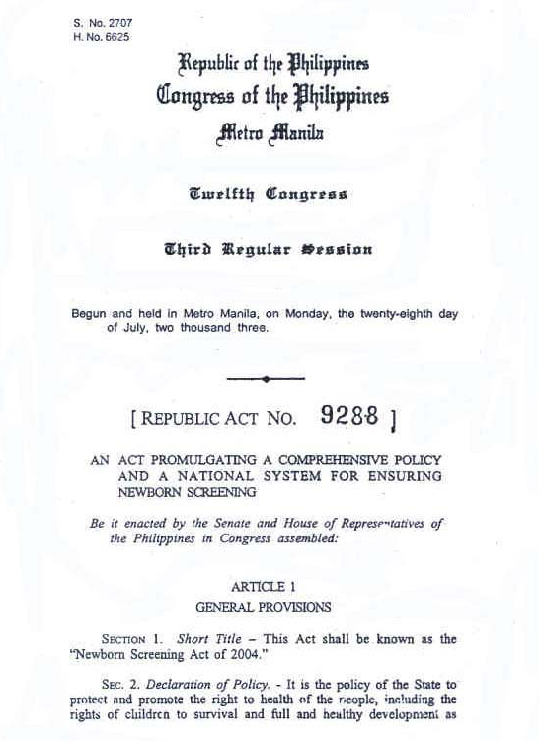
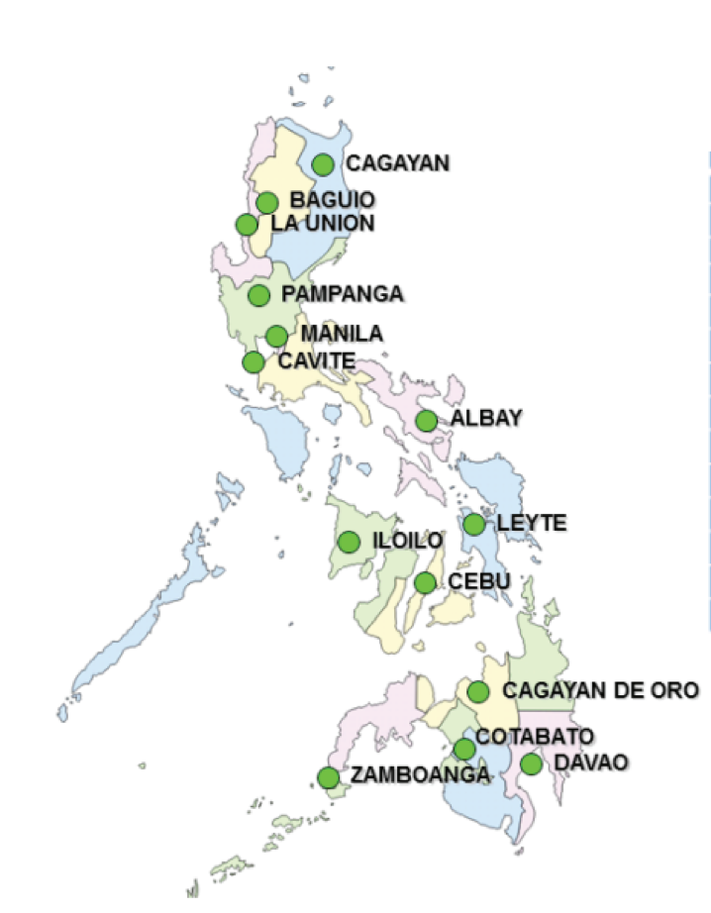
Twin Legislation
6 Newborn screening centers
14 Continuity clinics

Slide 7
Provisions in the pending UHC
Integrating the RDA Act
No one will be left behind
Health Technology Assessment
Expanded source of funding

Slide 8
PWRD Claim: Our Right to Life
DOH
&
Allied
Government
Agencies
NIH-IHG
Private
Sector &
Biopharma
PSOD
Sustainability
Collaboration

Slide 9
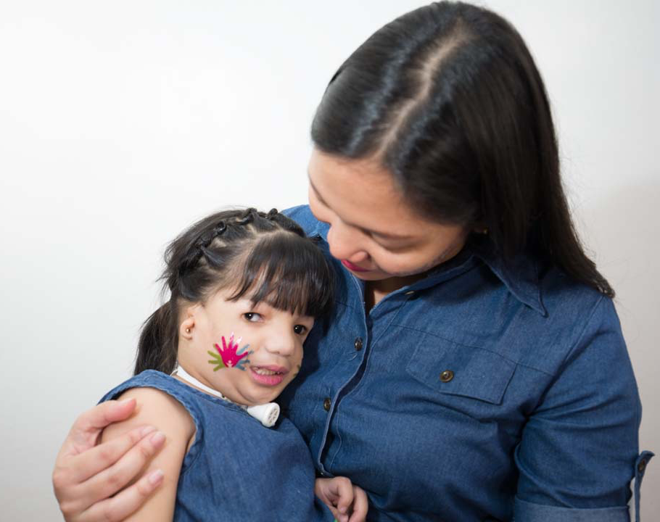
Someday soon, with our collective help,
patient families can feel…
”No disease is rare for someone you love”.
Because everyone has a right to life…
…and a right to a quality life.

Slide 10
Maraming Salamat
Thank You
Philippine Society for Orphan Disorders, Inc.
10

Slide 11
Acknowledgement for Rare Disease Act
Patients, their families and all its donors and sponsors
Geneticists and other health professionals

Slide 12
For further information, contact:
Cynthia K. Magdaraog
President
Philippine Society for Orphan Disorders, Inc.
Unit 507, Greenhills Mansion
37 Annapolis St., Greenhills 1502
San Juan City, Metro Manila, Philippines
+63.2.661.8935
cynthia@psod.org.ph
www.psod.org.ph
https://www.facebook.com/psod.org.ph/

