Slide 1
The Universal Health Coverage Political Declaration: an opportunity for rare diseases
Durhane Wong-Rieger
Chair of Rare Diseases International
President & CEO of Canadian Organization for Rare Disorders
RDI 5th Annual Meeting
February 20, 2019
Microsoft Headquarters, New York

Slide 2
What is universal health coverage?
WHO Definition:
All individuals and communities receive the health services they need without suffering financial hardship
Not just health financing. All components of health system: health service delivery systems, the health workforce, health facilities and communications networks, health technologies, information systems, quality assurance mechanisms, and governance and legislation.
Not only about ensuring a minimum package of health services, but also about ensuring a progressive expansion of coverage of health services and financial protection as more resources become available.
More than just health: taking steps towards universal health coverage means steps towards equity, development priorities, and social inclusion and cohesion

Slide 3
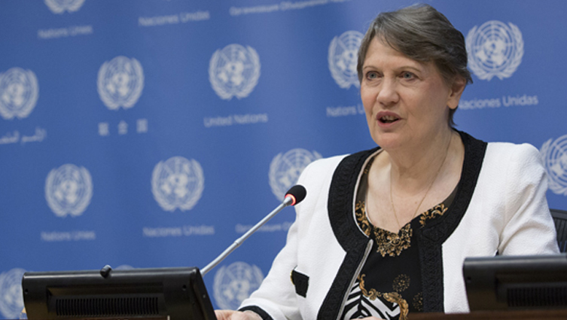
Universal health coverage: what about rare diseases?
One of the key commitments under Goal SDG 3, “ensuring healthy lives for all”, is to achieve universal health coverage and provide access to safe, effective, quality, and affordable essential medicines and vaccines for all
‘No country can claim to have achieved universal healthcare if it has not adequately and equitably met the needs of those with rare diseases’
Helen Clark, UNDP, 20 October 2016

Slide 4
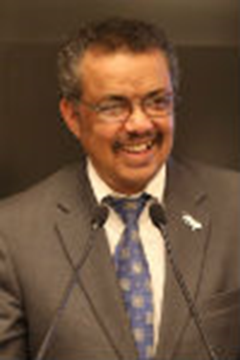
WHO’s TOP PRIORITY
“The vision of the Sustainable Development Goals is a world in which no one is left behind, including people who suffer from rare diseases. Just because a disease affects a small number of people does not make it irrelevant or less important than diseases that affect millions. WHO’s top priority is to support countries on the path towards universal health coverage, with the aim of ensuring that all people can access the health services they need. […] This includes access to diagnosis and treatment for people who suffer from rare diseases.”
Rare Disease Day Statement by
Dr Tedros Adhanom Ghebreyesus, WHO, February 2018

Slide 5
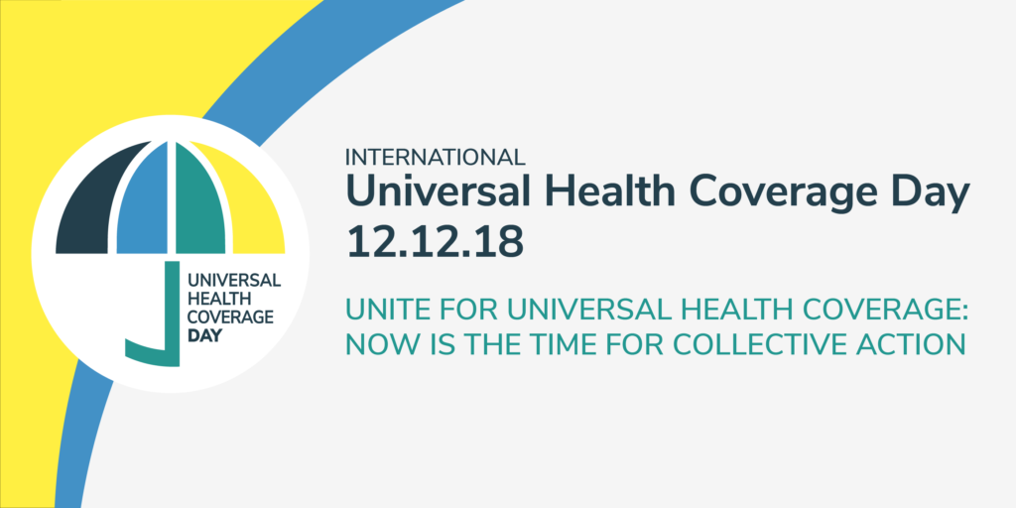
UN RESOLUTION ON UHC
UN General Assembly Resolution 72/139 on Universal Health Coverage
adopted on 12 December 2017
Established 12 December as UHC Awareness Day
Emphasis on need to address the health of the most vulnerable to progress towards the goal of universal health coverage

Slide 6
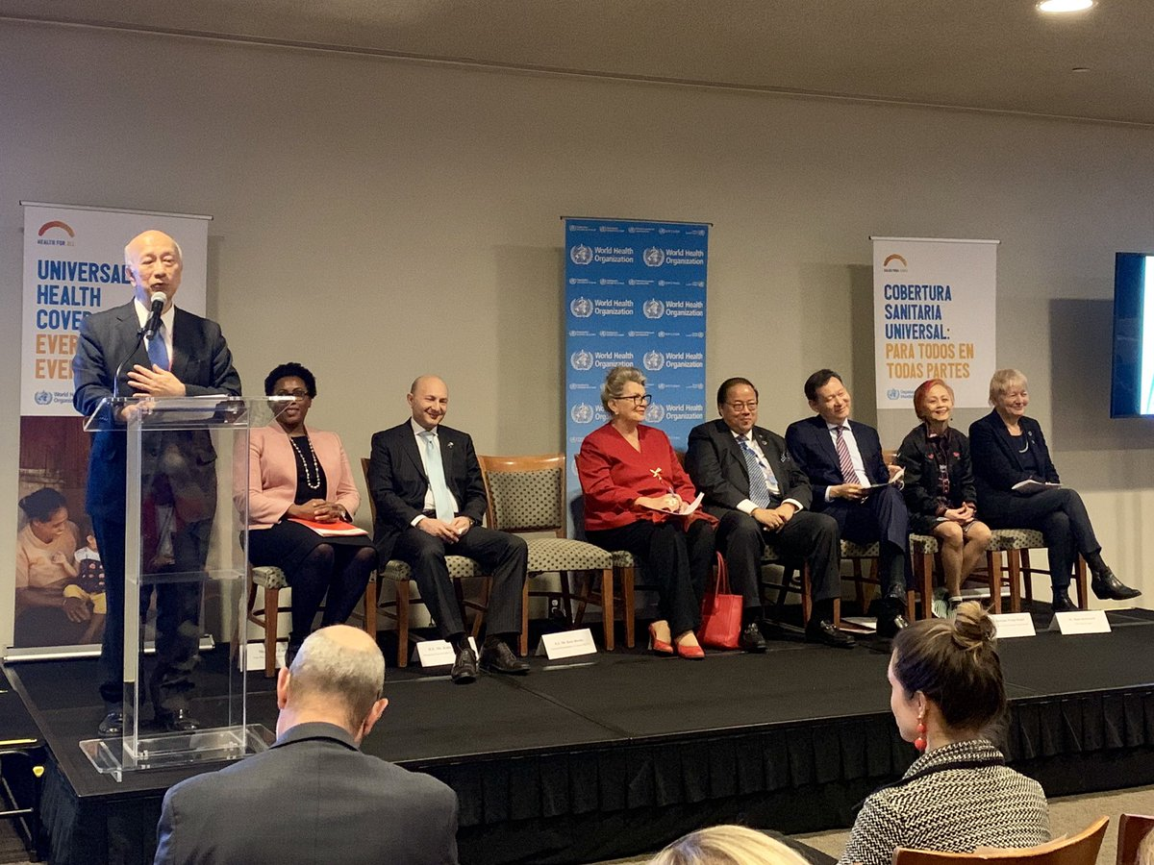
UNIVERSAL HEALTH COVERAGE
UHC Day Dec 12, 2018 -Panel discussion organised by WHO and Group of Friends of UHC (Japan, Brazil, France, Ghana, Hungary, South Africa, Thailand) at UN HQ, NY
RDI was the only NGO invited
WHO UN Offices, Ambassadors and Prof Kickbush – opening remarks on importance of patient engagement
Important to make the case for inclusion of RDs in UHC

Slide 7
Un POLITICAL Declaration on UHC
UN Political Declaration on UHC
To be adopted at High-Level Meeting on UHC during UNGA 74th Session (23 September 2019)
Outreach and briefings to Member States (through Permanent Missions in Geneva and New York and Ministries of Health and Ministries of Foreign Affairs in Capitals)
Target co-facilitator countries (Hungary and Thailand) and to drafting countries (France, Japan) and champion countries (EU Delegation, Philippines, Kuwait, others)
Objective: include Rare Diseases in the UN Political Declaration on UHC
RDI Position Paper on Rare Diseases and UHC

Slide 8
UNIVERSAL HEALTH COVERAGE
RDI Position Paper (full version 25 pages)
Executive Summary to be tabled at Rare Diseases at the UN Event 21 February
Tentative title: «Rare Diseases: The Missing Keystone of UHC»
RD and UHC movements share important commonalities in spirit and vision (focus on integrated approach, ‘more than just health’, human rights, equity and solidarity)
No UHC without RDs (literature review on theories of social justice, focus on the most vulnerable, UHC as a political / societal choice rather than purely economic)
Demonstrate the value added of UHC on the ground / Inclusion of RD in practical implementation of UHC

Slide 9
Universal Health Coverage
RDI Contribution to UN Political Declaration on Universal Health Coverage
Ad hoc group
Kelly Du Plessis, Rare Diseases South Africa
Cynthia Magdaraog, Philippines Society for Rare Disorders
Luciana Escati, FADEPOF, Argentina
Amanda Bok, European Hemophilia Consortium
Ask External Reviewers:
Natasha Azzopardi- Muscat- President of the European Public Health Association and a senior lecturer on health services management at the University of Malta
Ilona Kickbush, Head or Michaela Told, Global Health Centre, Geneva Graduate Institute
Gorik Ooms - human rights lawyer and a global health scholar, Professor of Global Health Law & Governance at the London School of Hygiene & Tropical Medicine
RDI Advocacy Committee →RDI Council →RDI Members

Slide 10
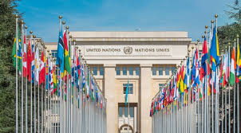
Save the date
WHO 72nd World Health Assembly
United Nations, Geneva
Rare Diseases and Universal Health Coverage
Informal Side Event
23 May 2019

