Slide 1
APARDO -Who we are and What we Do

Slide 2
Background
Considerable disparity across the Asia-Pacific region in terms of orphan drug and rare disease policy (due to varying levels of economic development, healthcare coverage and patient engagement)
Groups in Asia Pacific region made aware of each other through social media, participation in Rare Disease Day activities, international disease-specific environments and cross disease forums
Exploration of creating regional alliance with collective patient voice that could help leverage awareness and action in their own countries
October 2012 – patient advocates from across Asia Pacific met in Singapore to discuss common challenges and possibility of a regional collaboration to share experiences and learning, increasing strength of voice and addressing priority issues

Slide 3
Origins: Steering Committee Meeting
2014, Shenzhen, China
Steering Committee Meeting during the International Rare Disease Research Consortium conference
Agreed on the establishment of Asia Pacific Alliance of Rare Disease Organizations (APARDO) as legal entity in Singapore
APARDO established on 1 April 2015 with 7 Founding Board Members
26-27th October, 2018, Singapore: Members renew their commitment to forwarding the work of APARDO and elect a board of Directors.

Slide 4
APARDO’s Vision
APARDO’s Mission and Mandate
APARDO’s Objectives
To be a strong united voice in the Asia Pacific region on behalf of patients and families living with/affected by rare diseases
To help member organizations improve treatment
outcomes for those affected by rare diseases
(including rare cancers) in Asia-Pacific
Larger voice on rare diseases by integrating regional voices
Sharing information through active communications
Policy development for regional and national policies
Conduit for developing rare disease national alliances by connecting groups

Slide 5
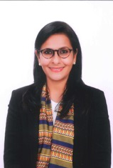
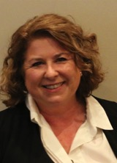
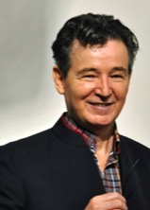
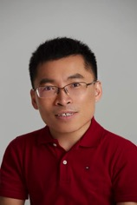
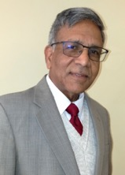
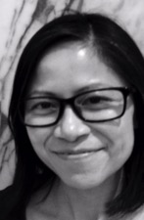
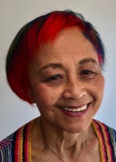
2019 APARDO Board of Directors
Ritu Jain (Dr)
President, APARDO
Fiona Wardman (Ms)
Director, APARDO
Bill Claxton (Mr)
Treasurer, APARDO
Kevin Huang (Mr)
Director, APARDO
Staff
Ramaiah Muthyala (Dr)
Secretary, APARDO
Grace Poon (Ms)
Administrative Assistant,
APARDO
Durhane Wong-Rieger (Dr)
Director, APARDO

Slide 6
APARDO Members
Members
Canadian Organization for Rare Disorders
Chinese Organization for Rare Disorders
Dakshayani And Amaravati Health and Education
Hong Kong Alliance for Rare Diseases
Indian Organisation for Rare Diseases
Lysosomal Storage Disorders Support Society
Rare Voices Australia Ltd
Affiliates Members
Carcinoid & Neuroendocrine Tumor Society
DEBRA Singapore

Slide 7
APARDO-APEC Rare Disease Network partnership
During APEC CEO Summit 2018, APEC LSIF Rare Disease Network announced official launch of APEC Rare Disease Action Plan
Action Plan outlines 10 key areas for action to tackle the challenges of rare disease
Action Plan calls for its 21-member economies to improve the economic and social inclusion of individuals living with rare diseases, with clear targets by 2025
APARDO invited to partner with the network in rolling out the action plan

Slide 8
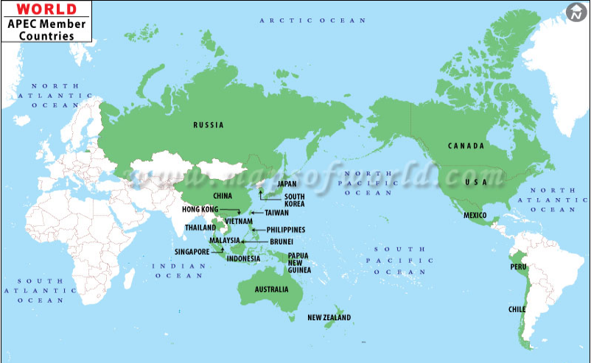
Asia-Pacific Economic Cooperation
21 Member Countries
2.8 billion people
Facilitates economic growth in region
59% of the worlds GDP
Responsible for 49% of world trade

Slide 9
Towards 2025
APEC RARE DISEASE ACTION PLAN FRAMEWORK
2.1 Vision 2025
EC member economies will aim to improve the economic and social inclusion of all those affected by rare diseases by addressing barriers to healthcare and social welfare services.
2.2 Objectives
1. Facilitate greater alignment of domestic policies and regulations;
2. Support urgent implementation of proven best practices;
3. Promote multisectoral collaborations and patient partnership
APARDO will align with the Vision and Objectives of the APEC Rare Disease Action Plan

Slide 10
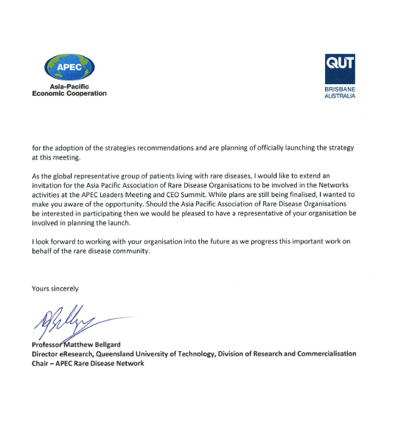
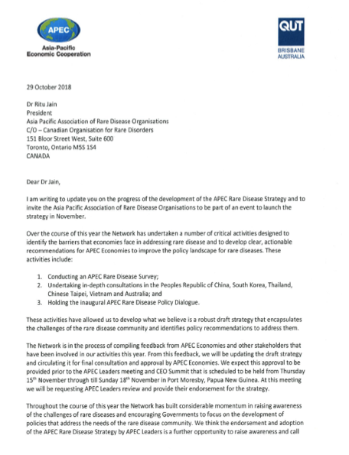
APARDO will engage actively with the APEC Rare Disease Network to deliver in APEC Rare Disease Action Plan in the Asia Pacific region

