Slide 1
Including Rare Diseases in the Disability agenda using the UN Convention on the Rights of Persons with Disabilities
Lieven Bauwens
Secretary General, International Federation for Spina Bifida and Hydrocephalus
Board member, Eurordis
20 February 2019

Slide 2
What I want to talk about
Very briefly about my organisation
CRPD in brief
Advocacy example: Right to Health

Slide 3
International Federation for Spina Bifida and Hydrocephalus

Slide 4
Spina Bifida (NTDs)

Slide 5
Hydrocephalus

Slide 6
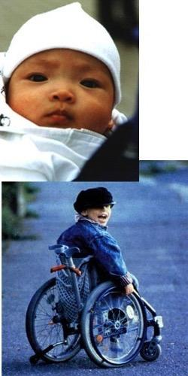
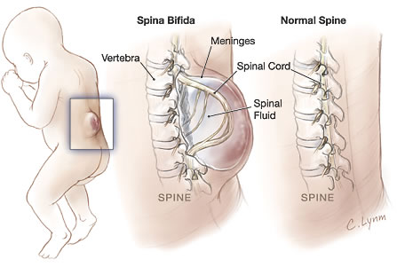
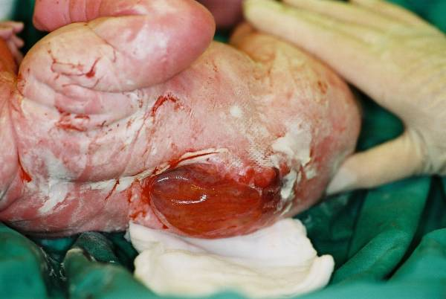
Perception

Slide 7
Convention on the Rights of Persons with Disabilities

Slide 8
Some history
Adopted: 13 December 2006
Open for signature: 30 March 2007
Paradigm shift: “nothing about us, without us” (article 4.3. “In the development and implementation of legislation and policies to implement the present Convention, and in other decision-making processes concerning issues relating to persons with disabilities, States Parties shall closely consult with and actively involve persons with disabilities, including children with disabilities, through their representative organizations”) (article 33.3: “Civil society, in particular persons with disabilities and their representative organizations, shall be involved and participate fully in the monitoring process.”)
Almost reaching universal ratification

Slide 9
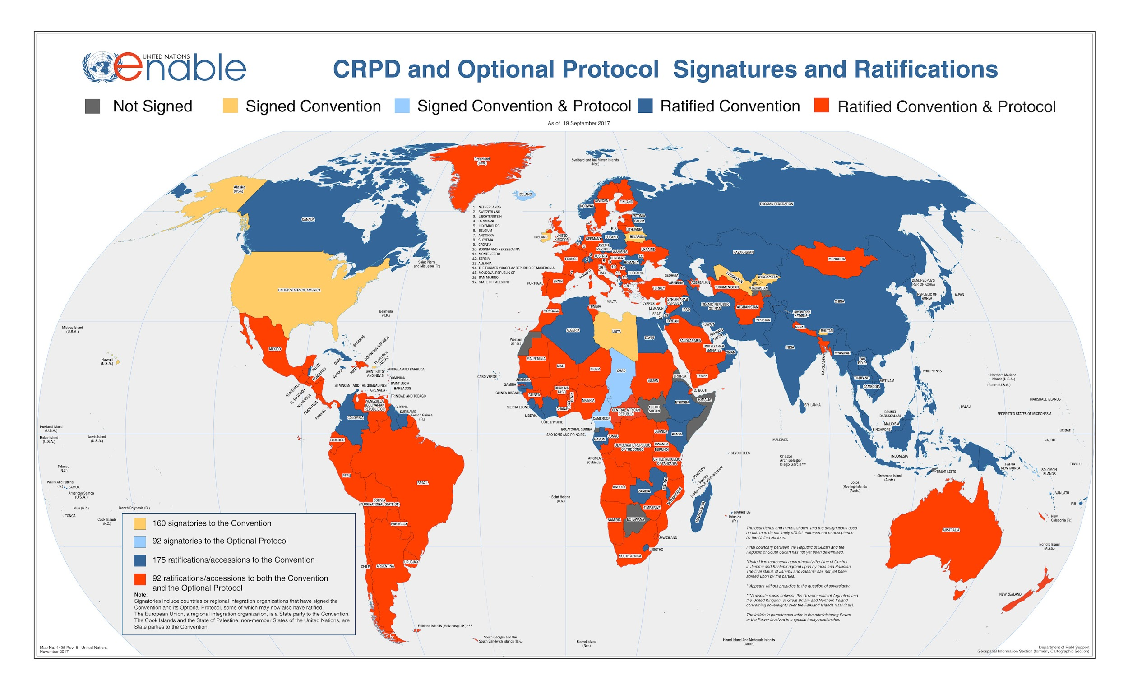
Current status of signatures and ratifications
Accessed 15 february 2019, http://www.un.org/disabilities/documents/maps/enablemap.jpg

Slide 10
Monitoring
Conference of State Parties to the Convention of the Rights of Persons with Disabilities
CRPD Committee
Special Rapporteur

Slide 11
CRPD Committee state review process (at OHCHR)
STATE
submits report
COMMITTEE
list of issues
COMMITTEE’s
follow-up
STATE
implements recommendations
STATE
submits answers
COMMITTEE’s
concluding observations
COMMITTEE’S SESSION
State presents the report and respond to the Committee’s questions

Slide 12
Where we can intervene
Civil society
Civil society
STATE
submits report
COMMITTEE’s
follow-up
COMMITTEE
list of issues
STATE
implements recommendations
STATE
submits answers
COMMITTEE’s
concluding observations
COMMITTEE’S SESSION
Civil society
At national and international level, alone and with partners

Slide 13
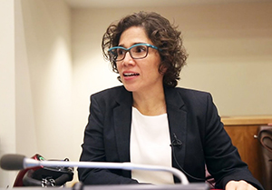
Special Rapporteur
Mandate:
Regular dialogue
Receive and exchange information;
Consult with and involve pwd and organisations;
Make concrete recommendations;
Provide technical assistance;
Raise awareness of the rights of persons with disabilities;
Closely cooperate with UN human rights mechanisms and UN entities;
Integrate a gender perspective t;
Report annually to the Human Rights Council and the General Assembly.
How:
Communications
Country visits
Speeches and presentations
Annual reports
Catalina Devandas Aguilar

Slide 14
Case: Right to Health

Slide 15
Article 18 - Liberty of movement and nationality
1. States Parties shall recognize the rights of persons with disabilities to liberty of movement, to freedom to choose their residence and to a nationality, on an equal basis with others, including …
2. Children with disabilities shall be registered immediately after birth and shall have the right from birth to a name, the right to acquire a nationality and, as far as possible, the right to know and be cared for by their parents.

Slide 16
Data

Slide 17
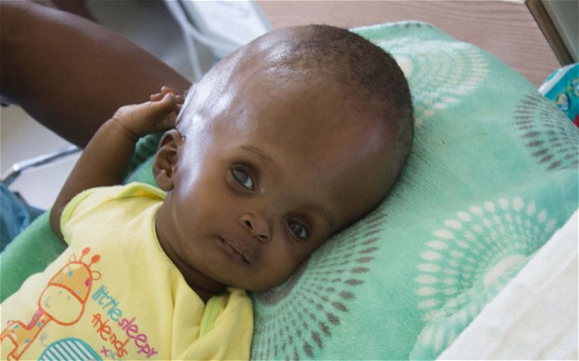
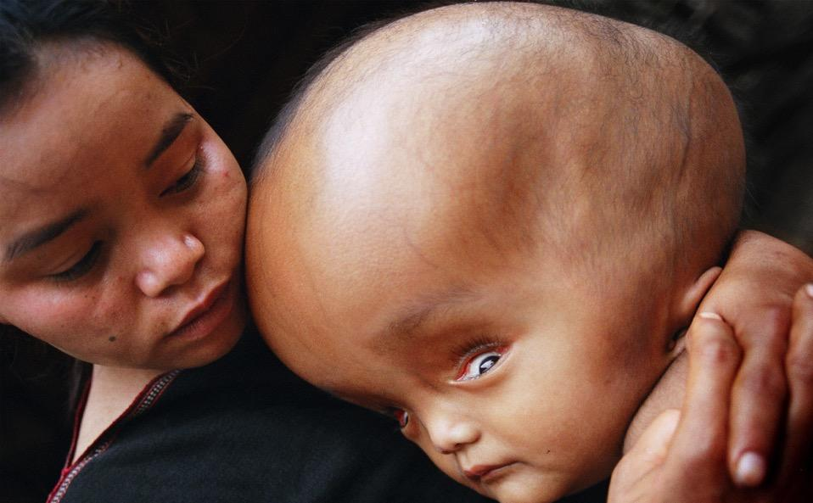
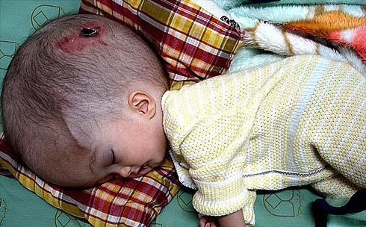
Unfortunately

Slide 18
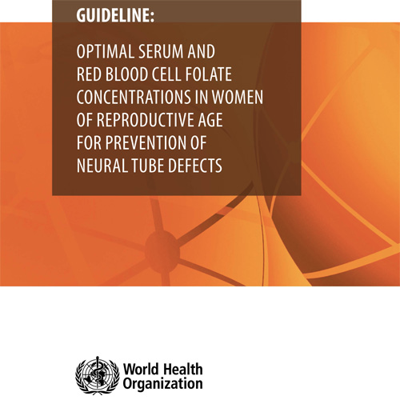
Focus on surveillance
Data drives efforts in prevention
Data drives efforts in care provision

Slide 19
CRPD Article 25 – Health (1/4)
States Parties recognize that persons with disabilities have the right to the enjoyment of the highest attainable standard of health without discrimination on the basis of disability. States Parties shall take all appropriate measures to ensure access for persons with disabilities to health services that are gender-sensitive, including health-related rehabilitation.

Slide 20
CRPD Article 25 – Health (2/4)
In particular, States Parties shall:
a. Provide persons with disabilities with the same range, quality and standard of free or affordable health care and programmes as provided to other persons, including in the area of sexual and reproductive health and population-based public health programmes;
b. Provide those health services needed by persons with disabilities specifically because of their disabilities, including early identification and intervention as appropriate, and services designed to minimize and prevent further disabilities, including among children and older persons;

Slide 21
CRPD Article 25 – Health (3/4)
c. Provide these health services as close as possible to people’s own communities, including in rural areas;
d. Require health professionals to provide care of the same quality to persons with disabilities as to others, including on the basis of free and informed consent by, inter alia, raising awareness of the human rights, dignity, autonomy and needs of persons with disabilities through training and the promulgation of ethical standards for public and private health care;

Slide 22
CRPD Article 25 – Health (4/4)
e. Prohibit discrimination against persons with disabilities in the provision of health insurance, and life insurance where such insurance is permitted by national law, which shall be provided in a fair and reasonable manner;
f. Prevent discriminatory denial of health care or health services or food and fluids on the basis of disability.

Slide 23
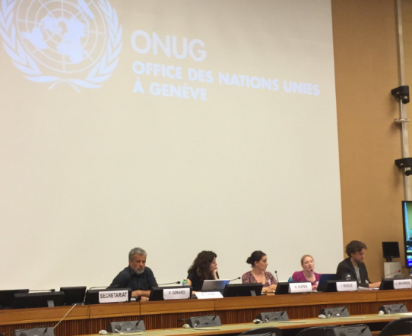
Special Rapporteur Disability: Preparation Annual Report to UNGA
Including Rare Diseases in the Human Rights & Disability Agendas
On 15 and 16 May 2018, RDI participated in an Expert Group Meeting convened by the Special Rapporteur on the right of persons with disabilities to the highest attainable standard of physical and mental health. The meeting took place at the UN in Geneva and served to consult with disability organisations on the content of the Report.

Slide 24
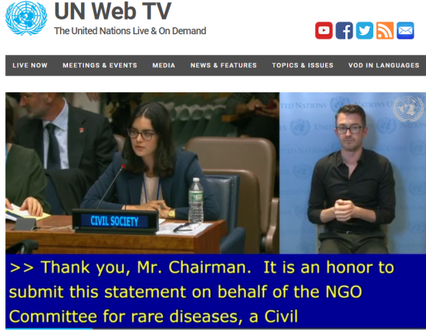
2. Build on the progress made in creating a favourable environment
Rare Diseases and the Rights of persons with disabilities
1) Conference of States parties to Convention on the Rights of Persons with disability in New York – 12 to 14 June 2018
Oral Statement delivered by Clara Hervas (EURORDIS) on behalf of NGO Committee for Rare Diseases
2) Report of the United Nations Special Rapporteur on the Rights of persons with disabilities: Catalina Devandas
Mention to rare diseases in report to the UN General Assembly in September 2018 (*)
“Health systems must respond to the needs of the diversity of persons with disabilities. […]. States should consider developing and implementing policies and practices targeting the most marginalized groups of persons with disabilities (e.g., persons with multiple or severe impairments, rare diseases or deaf-blindness) in order to accelerate or achieve de facto equality in access to health care.”
* https://www.ohchr.org/Documents/Issues/Disability/A_73_161_EN.pdf

Slide 25
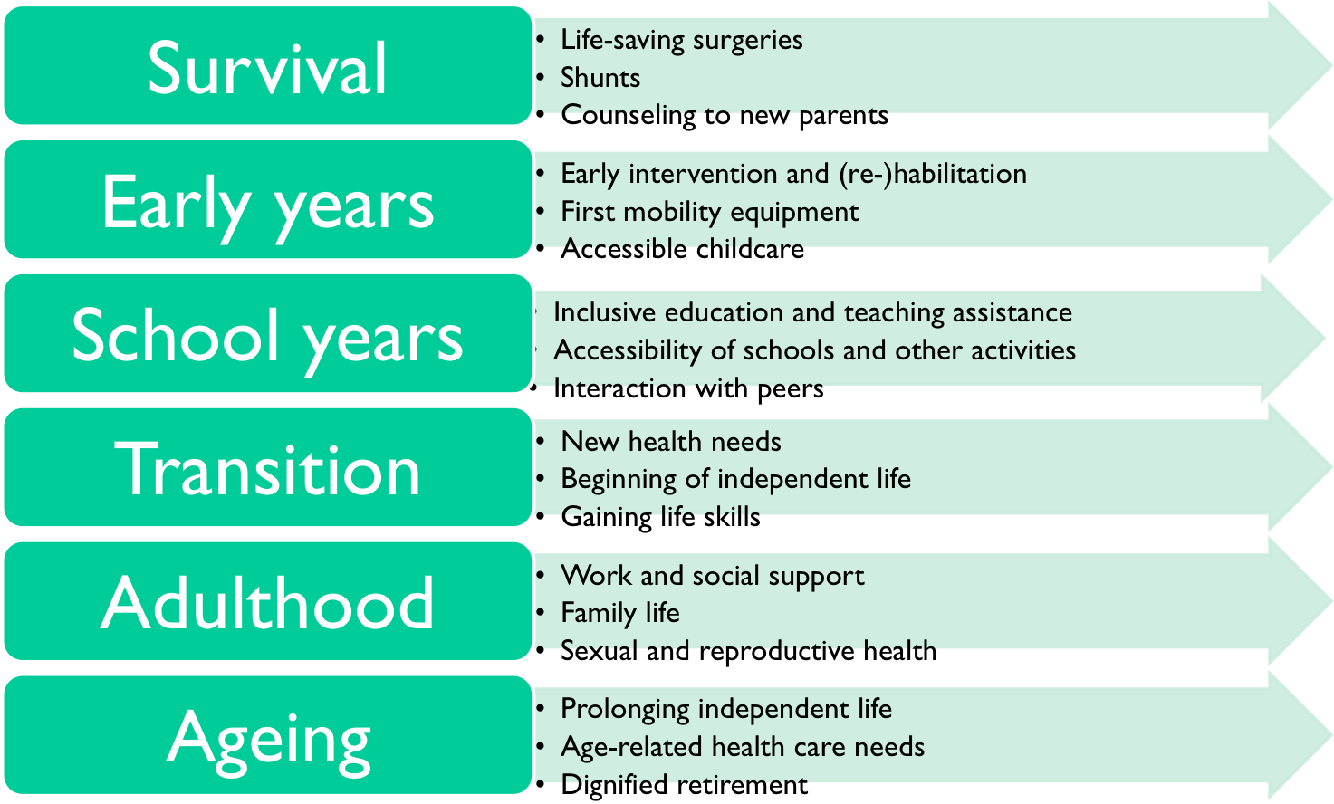
Life long care
LIC
MIC
HIC

Slide 26
CRPD Committee state review process (at OHCHR)
STATE
submits report
COMMITTEE
list of issues
COMMITTEE’s
follow-up
STATE
implements recommendations
STATE
submits answers
COMMITTEE’s
concluding observations
COMMITTEE’S SESSION
State presents the report and respond to the Committee’s questions

Slide 27
Where we can intervene
Civil society
Civil society
STATE
submits report
COMMITTEE’s
follow-up
COMMITTEE
list of issues
STATE
implements recommendations
STATE
submits answers
COMMITTEE’s
concluding observations
COMMITTEE’S SESSION
Civil society
At national and international level, alone and with partners

Slide 28
Example: review of EU (2015)
The state report (2014) gives a long overview on competences and actions of the European Union in the area of health
Health (art. 25) 29. Please explain how the European Union can prevent disability-based discrimination in health-care service provision and ensure the training of health-care professionals on the human rights of persons with disabilities, in the light of its shared competences with the European Union member States in the field of health care. Committee’s list of issues to European Union
Responses by European Commission (my summary)
Referral to competences of EU and member states
EU Health programme supporting exchange of best practise
Announcement of pilot project
European Union’s response to the Committee

Slide 29
Concluding observations (Sept 2015)
Health (art. 25)
62. The Committee is concerned that discrimination on the grounds of disability is not explicitly prohibited in the field of health care. It notes the barriers faced by persons with disabilities in accessing health care in different member States.
63. The Committee recommends that the European Union explicitly prohibit discrimination on the grounds of disability in the field of health care and take measures to ensure access to quality health care for all persons with all types of disabilities. It also recommends that the European Union evaluate the impact of the European Parliament and the Council of the European Union Directive 2011/24/EU on patients’ rights in cross-border health care with regard to gaps in access for persons with disabilities, including accessible information, reasonable accommodation and training of professionals.

Slide 30
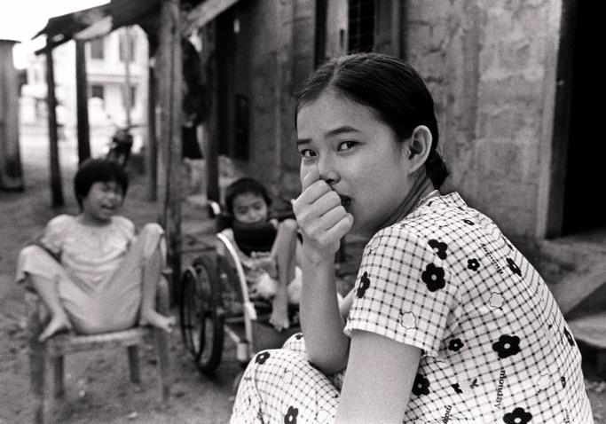
Thank you!
Lieven Bauwens
lieven.bauwens@ifglobal.org

Slide 31
Pictures
Pictures were taken from different sources to illustrate my presentation
International Federation for Spina Bifida and Hydrocephalus, Pierre Mertens, Lieven Bauwens, Ernie Bufflo, Aaron Fotheringham, the Telegraph, Redefining Spina Bifida, Adriana Tontsh, dr. Ahuka Longombe, KSL news, the Food Fortification Initiative, Dieter Telemans (CCBRT), Donna Rose, Zero Project, OHCHR

