Slide 1
Overview of High-Level Events of the NGO Committee for Rare Diseases at the United Nations
Yann Le Cam on behalf of Anders Olauson,
Chair of NGO Committee for Rare Diseases
RDI 5th Annual Meeting
20 February 2019, New York

Slide 2
Introduction to the Committee
CoNGO as our home
CoNGO strives to be a platform for a civil society represented by a global community of informed, empowered and committed NGOs that fully participate with the UN in decision-making and programs leading to a world of economic and social justice
CoNGO has NGO Substantive Committees: they bring together NGOs, members of the CoNGO secretariat, UN representatives and national government delegations to discuss pertinent themes and issues before the UN and the international community
CoNGO’s NGO Committees operate in Geneva, New York and Vienna

Slide 3
Introduction to the Committee
The NGO Committee for Rare Diseases is a Substantive Committee based in New York, of the Conference of NGOs having a Consultative Relationship with the United Nations (CoNGO)
Goal: platform to promote rare diseases as a priority in the UN 2030 Agenda: the Sustainable Development Goals (SDGs)
Who is involved?
Initiative by Ågrenska Foundation & EURORDIS – Rare Diseases Europe, with Rare Diseases International joining later
Supported by 34 NGOs from CoNGO
Forum for interested parties (NGOs, ECOSOC members, UN bodies, individual experts)

Slide 4
Promote rare diseases as a global priority in UN SDGs 2030 Agenda
An inclusive, multi-stakeholder ecosystem to share knowledge and expertise about rare diseases and to increase global visibility of rare diseases
Mission
Vision

Slide 5
Inception Executive Board

Slide 6
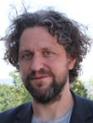
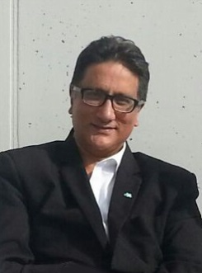
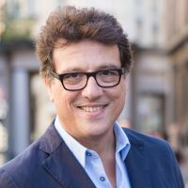
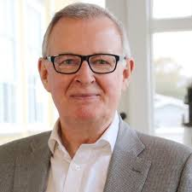
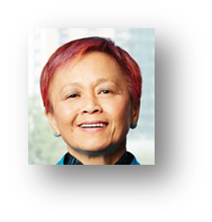
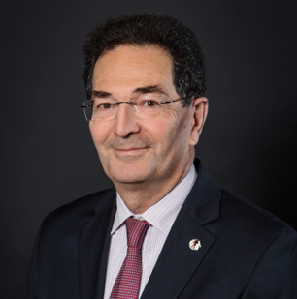
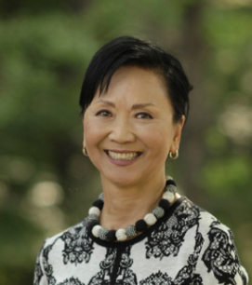
Representatives: Inception Exec Board
Lieven Bauwens
Yann Le Cam
Anders Olauson
Kawaldip Sehmi
Alain Weill
Durhane Wong-Rieger
Soon-Young Yoon

Slide 8
1st High Level Event: Launch of NGO Committee
UN HQ, NY
November 11, 2016

Slide 9
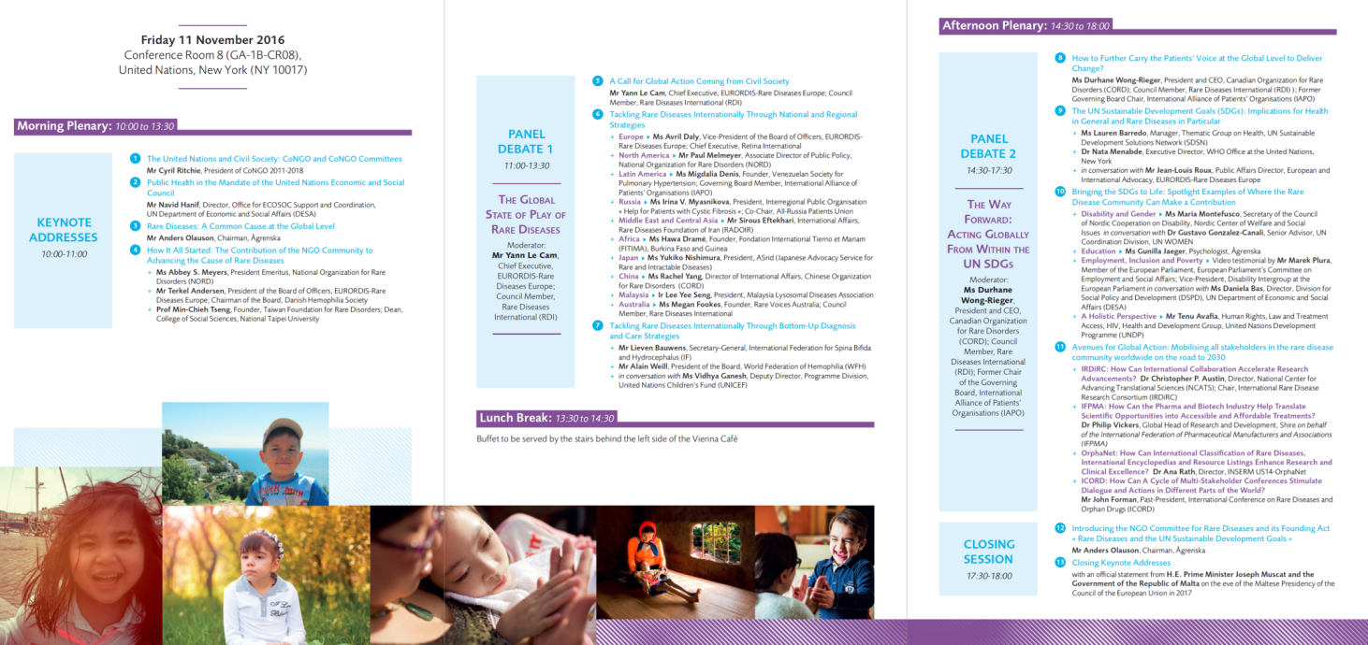
1st High Level Event: Launch of NGO Committee
A full one-day programme dedicated to rare diseases with high level officials of ECOSOC, DESA, UNDP, UNICEF, WHO

Slide 10
A Milestone in the Journey to put Rare Diseases in the Global Agenda

Slide 11
2nd High Level Event
Rare Disease Day Policy Event
at the United Nations
Second High-Level Event of the NGO Committee for Rare Diseases
21st February 2019
United Nations Headquarters, New York

Slide 13
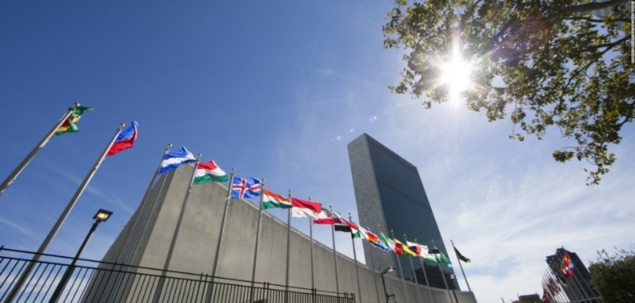
Organisation
The event is a policy event for Rare Disease Day 2019
It is the 2nd High-Level event of the ‘NGO Committee for Rare Diseases’
Organised and co-funded by:
Date and Location: 21st February 2019 at the United Nations Headquarters in NYC

Slide 14
Co-hosting countries
(Co-hosting lead)
The Permanent Mission of Japan
to the United Nations
Permanent Mission of Thailand to the UN
Permanent Mission of the
Republic of Malta to the UN
Not co-hosting but showing interest:
Dominican Republic, EU Delegation, Germany, Iran, Serbia, Uruguay

Slide 15
Royal Patronage
2016
2019

Slide 16
Who will be in the room?
Member States Permanent Mission Officials
UN & UN Agencies Staff or Officials
Other NGOs from CoNGO that supported the Committee
Other NGOs with ECOSOC status
Stakeholders (pharma, digital, research, etc.)
RDI members and other patient organisations acting at international level

Slide 17
Specific Objectives
Re-affirm that Rare Diseases cannot be ignored « Leave No One Behind » and can contribute to SDGs 2030, building on event Nov 2016 and on the progress made
Promote the integration of rare diseases into the Universal Health Coverage UN Political Declaration
Show the challenges of rare diseases and the value of adressing them with international an national strategies, calling for a UN General Assembly Resolution

Slide 18
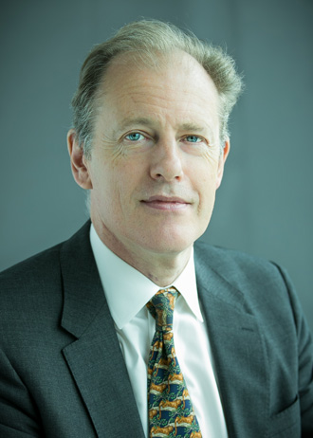
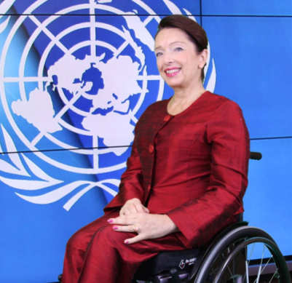
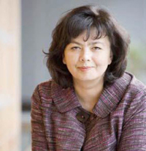
Programme Highlights
Andrew Gilmour, Assistant Secretary-General for Human Rights & Head of OHCHR Office in New York
Daniela Bas, Director at the UN Department of Economic and Social Affairs, Division for Social Policy and Development
Nata Menabde, Executive Director of WHO Office at the United Nations, New York

Slide 19
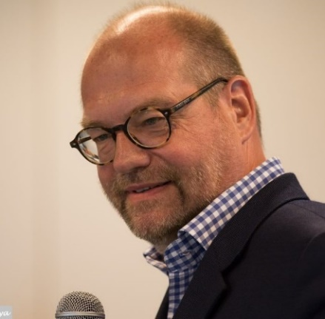
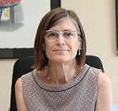
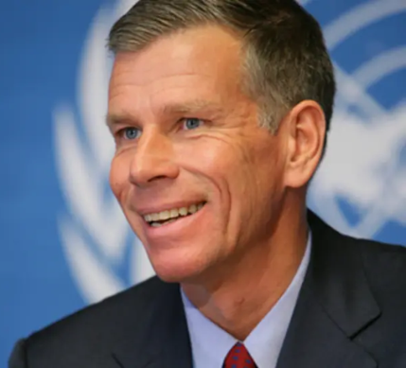
Programme Highlights
Ruediger Krech, Director for Universal Health Coverage and Health Systems at the World Health Organization
Pilar Aparicio, Director General of Public Health, Quality and Innovation at the Spanish Ministry of Health, Consumption and Social Welfare
Anders Nordström, Swedish Ambassador for Global Health at the Ministry for Foreign Affairs

Slide 20
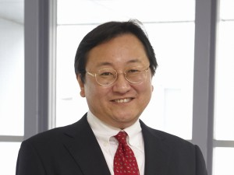
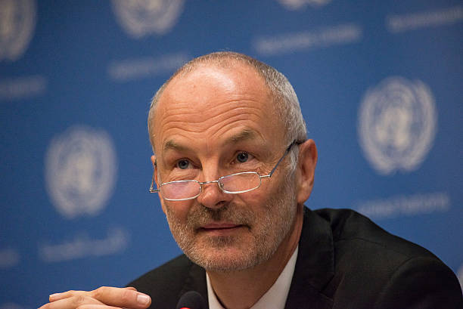
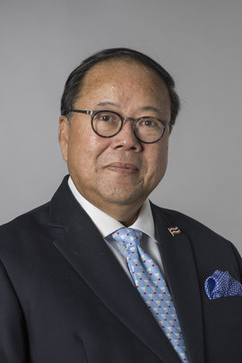
Programme Highlights
H.E. Toshiya Hoshino, Ambassador and Deputy Permanent Representative of Japan to the United Nations
H.E. Sven Jürgenson, Ambassador and Permanent Representative of Estonia to the United Nations.
H.E. Vitavas Srivihok, Ambassador and Permanent Representative of Thailand to the United Nations

Slide 21
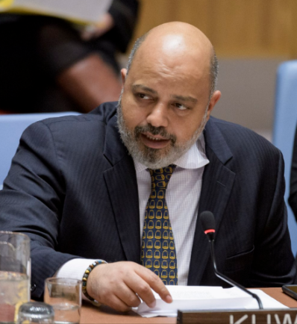
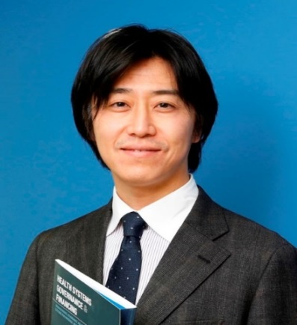
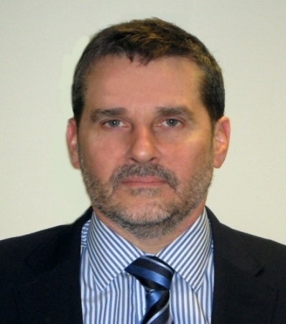
Programme Highlights
Tareq Albanai, Political Coordinator at the Permanent Mission of Kuwait to the United Nations.
Satoshi Ezoe, Counsellor covering Health at the Permanent Mission of Japan to the United Nations
Ricardo Monteiro, Minister-Counselor responsible for Human Rights and Humanitarian Affairs at the Permanent Mission of Brazil to the UN

Slide 22
Follow the event online and engage on social media!
Webcast available live via
Live-Tweeting via
@ngorarediseases
#RareDiseaseDay
#LeaveNoOneBehind

